Slide 1

Module 7
Part 3: Special cases & the Dual
To accompany
Quantitative Analysis for Management, Tenth Edition, by Render, Stair, and Hanna
Power Point slides created by Jeff Heyl
© 2009 Prentice-Hall, Inc.

Slide 2
Learning Objectives
After completing this chapter, students will be able to:
Identify the special cases in the simplex method from the simplex tableaus
Do sensitivity analysis – from computer output only (see chapter 7)
Formulate the dual for an LP problem

Slide 3
Special Cases
We have seen how special cases arise when solving LP problems graphically
They also apply to the simplex method
The four cases are
  Infeasibility
  Unbounded Solutions
  Degeneracy
  Multiple Optimal Solutions

Slide 4
Infeasibility
Min Problem with infeasibility (in Final Tableau)
C_{j} |  | $5 | $8 | $0 | $0 | $M | $M
 | SOLUTION MIX | X₁ | X₂ | S₁ | S₂ | A₁ | A₂ | QUANTITY
$5 | X₁ | 1 | 0 | –2 | 3 | –1 | 0 | 200
$8 | X₂ | 0 | 1 | 1 | 2 | –2 | 0 | 100
$M | A₂ | 0 | 0 | 0 | –1 | –1 | 1 | 20
 | Z_{j} | $5 | $8 | –$2 | $31 – M | –$21 – M | $M | $1,800 + 20M
 | Cj – Zj | $0 | $0 | $2 | $M – 31 | $2M + 21 | $0
Table 9.11
Artificial variable is still in the mix

Slide 5
Unbounded Solutions
Max problem with an unbounded solution (before Final tableau)
C_{j} |  | $6 | $9 | $0 | $0
 | SOLUTION MIX | X₁ | X₂ | S₁ | S₂ | QUANTITY
$9 | X₂ | –1 | 1 | 2 | 0 | 30
$0 | S₂ | –2 | 0 | –1 | 1 | 10
 | Z_{j} | –$9 | $9 | $18 | $0 | $270
 | C_{j} - Z_{j} | $15 | $0 | –$18 | $0
Pivot column
Table 9.12
Determining Pivot Row
Row X₂ :30/-1 =-30
Row X₁ : 10/-2 = -5
Both negative thus: unbounded Solution

Slide 6
Degeneracy
Max problem illustrating degeneracy (before final tableau)
C_{j} |  | $5 | $8 | $2 | $0 | $0 | $0
 | SOLUTION MIX | X₁ | X₂ | X₃ | S₁ | S₂ | S₃ | QUANTITY
$8 | X₂ | 0.25 | 1 | 1 | –2 | 0 | 0 | 10
$0 | S₂ | 4 | 0 | 0.33 | –1 | 1 | 0 | 20
$0 | S₃ | 2 | 0 | 2 | 0.4 | 0 | 1 | 10
 | Z_{j} | $2 | $8 | $8 | $16 | $0 | $0 | $80
 | C_{j} - Z_{j} | $3 | $0 | –$6 | –$16 | $0 | $0
Pivot column
Table 9.13

Slide 7
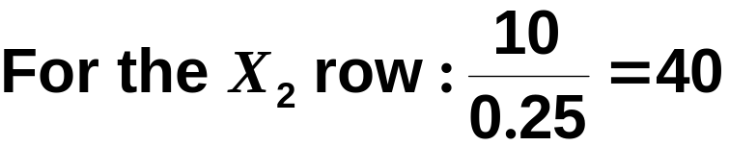
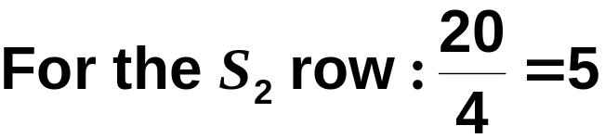
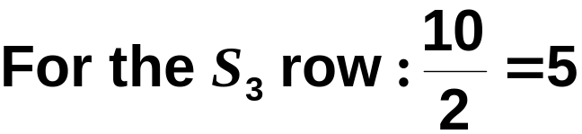
Degeneracy
The ratios are computed as follows
Tie for the smallest ratio indicates degeneracy

Slide 8
Multiple Optimal Solutions
Max problem with alternate optimal solutions (in Final Tableau)
C_{j} |  | $3 | $2 | $0 | $0
 | SOLUTION MIX | X₁ | X₂ | S₁ | S₂ | QUANTITY
$2 | X₂ | 1.5 | 1 | 1 | 0 | 6
$0 | S₂ | 1 | 0 | 0.5 | 1 | 3
 | Z_{j} | $3 | $2 | $2 | $0 | $12
 | C_{j} - Z_{j} | $0 | $0 | –$2 | $0
Table 9.14

Slide 9
Sensitivity Analysis
3 Types (from Chapter 7 practical):
  Change in technological coefficients
  Change in the RHS
  Change in the objective function coefficients
(only be able to perform with computer output or by hand, not on simplex tableaus)

Slide 10
Formulating the Dual
Every primal LP has a dual
The dual provides economic information about the LP problem
Dual represents the potential worth of resources, i.e. dual value or shadow price of a constraint
Dual values are obtained when we solve the dual with the simplex method

Slide 11
Steps to Form the Dual
If the primal is a maximization problem in the standard form, the dual is a minimization, and vice versa
The RHS values of the primal constraints become the dual’s objective coefficients
The primal objective function coefficients become the RHS values of the dual constraints
The transpose of the primal constraint coefficients become the dual constraint coefficients
Constraint inequality signs are reversed

Slide 12
Example M7-36
Max Profit = 50X₁+ 120X₂
Subject to 2X₁ + 4X₂ ≤ 80
3X₁ + 1X₂ ≤ 60
Dual:
Min Opportunity cost = 80U₁+60U₂
Subject to 2U₁+3U₂ ≥ 50
4U₁+1U₂ ≥ 120

Slide 13
Solving the Dual of the High Note Sound Company Problem
Comparison of the primal and dual optimal tableaus
Primal’s Optimal Solution
C_{j} |  | $50 | $120 | $0 | $0
 | Solution Mix | X₁ | X₂ | S₁ | S₂ | Quantity
$120 | X₂ | 0.5 | 1 | 0.25 | 0 | 20
$0 | S₂ | 2.5 | 0 | –0.25 | 1 | 40
 | Z_{j} | 60 | 120 | 30 | 0 | $2,400
 | C_{j} – Z_{j} | –10 | 0 | –30 | 0
Dual’s Optimal Solution
C_{j} |  | 80 | 60 | 0 | 0 | M | M
 | Solution Mix | U₁ | U₂ | S₁ | S₂ | A₁ | A₂ | Quantity
80 | U₁ | 1 | 0.25 | 0 | –0.25 | 0 | 0.5 | 30
0 | S₁ | 0 | –2.5 | 1 | –0.5 | –1 | 0.25 | 10
 | Z_{j} | 80 | 20 | 0 | –20 | 0 | 20 | $2,400
 | C_{j} – Z_{j} | 0 | 40 | 0 | 20 | M | M – 20
Figure 9.5

